Slide 1


Lab 6
Softmax Classifier
With TF 1.0!
Sung Kim <hunkim+ml@gmail.com>
Code: https://github.com/hunkim/DeepLearningZeroToAll/

Slide 2

Call for comments
Please feel free to add comments directly on these slides
Other slides: https://goo.gl/jPtWNt
Picture from http://www.tssablog.org/archives/3280

Slide 3
Lab 6-1
Softmax Classifier
With TF 1.0!
Sung Kim <hunkim+ml@gmail.com>
Code: https://github.com/hunkim/DeepLearningZeroToAll/

Slide 4

https://github.com/hunkim/DeepLearningZeroToAll/

Slide 5
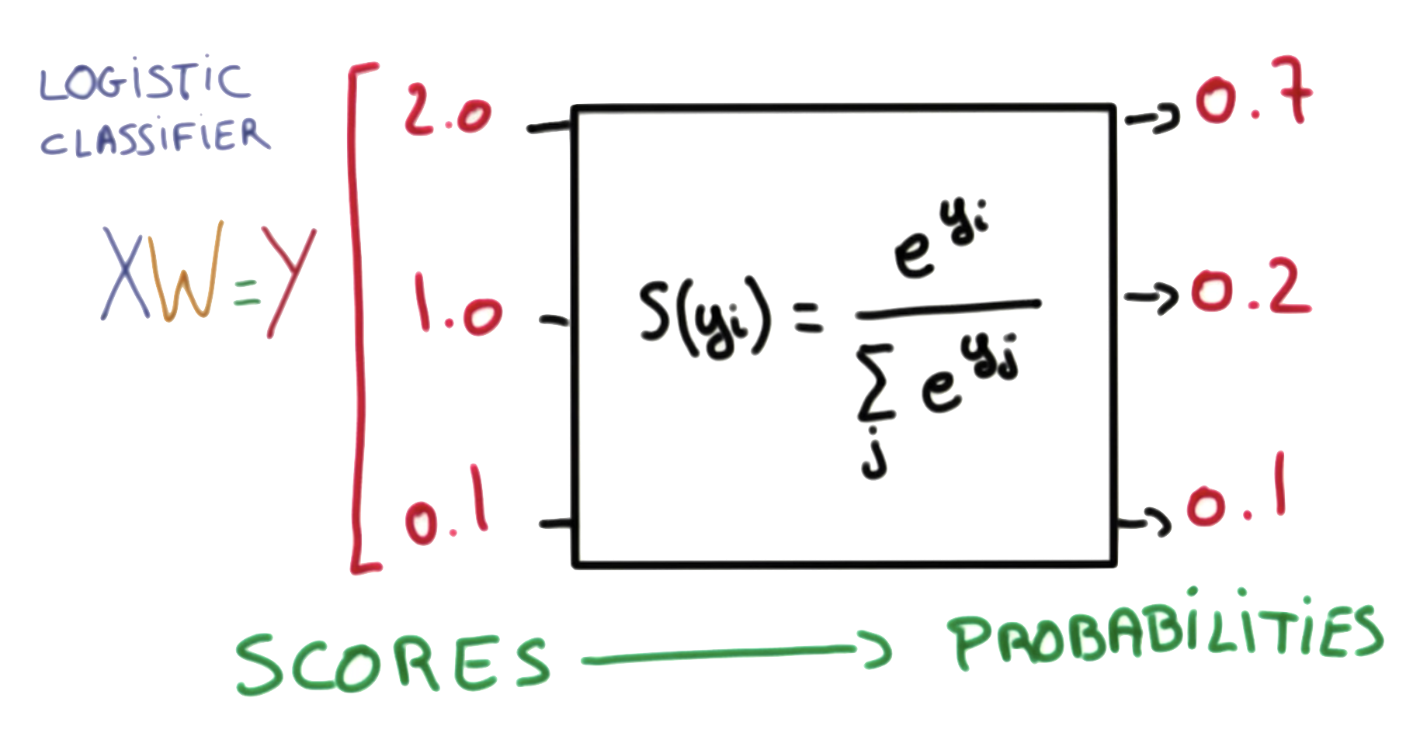
Softmax function
https://www.udacity.com/course/viewer#!/c-ud730/l-6370362152/m-6379811817
Notes:
P(y=i|x) = S(y_{i}) = \frac{e^{y_{i}}}{\sum_{j}e^{y_{j}}} \in (0,1)

Slide 6
hypothesis = tf.nn.softmax(tf.matmul(X,W)+b)
tf.matmul(X,W)+b
https://www.udacity.com/course/viewer#!/c-ud730/l-6370362152/m-6379811817

Slide 7
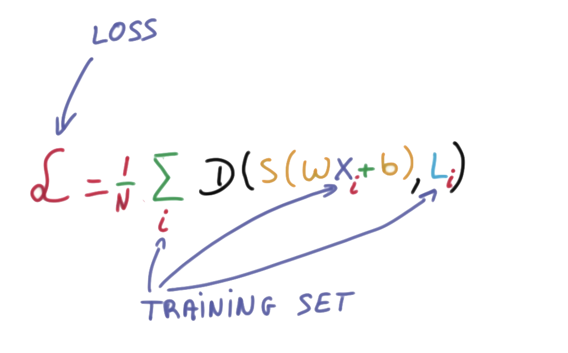
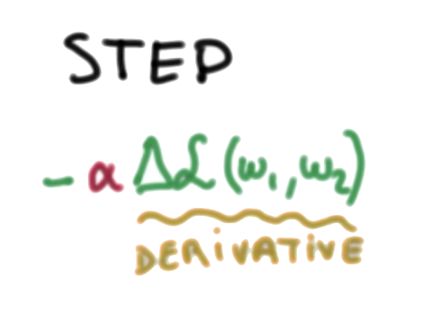
Cost function: cross entropy
# Cross entropy cost/loss
cost = tf.reduce_mean(-tf.reduce_sum(Y * tf.log(hypothesis), axis=1))
optimizer = tf.train.GradientDescentOptimizer(learning_rate=0.1).minimize(cost)
https://www.udacity.com/course/viewer#!/c-ud730/l-6370362152/m-6379811817

Slide 8
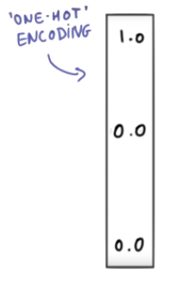
x_data = [[1, 2, 1, 1], [2, 1, 3, 2], [3, 1, 3, 4], [4, 1, 5, 5], [1, 7, 5, 5],
[1, 2, 5, 6], [1, 6, 6, 6], [1, 7, 7, 7]]
y_data = [[0, 0, 1], [0, 0, 1], [0, 0, 1], [0, 1, 0], [0, 1, 0], [0, 1, 0], [1, 0, 0], [1, 0, 0]]
X = tf.placeholder("float", [None, 4])
Y = tf.placeholder("float", [None, 3])
nb_classes = 3
W = tf.Variable(tf.random_normal([4, nb_classes]), name='weight')
b = tf.Variable(tf.random_normal([nb_classes]), name='bias')
# tf.nn.softmax computes softmax activations
# softmax = exp(logits) / reduce_sum(exp(logits), dim)
hypothesis = tf.nn.softmax(tf.matmul(X, W) + b)
# Cross entropy cost/loss
cost = tf.reduce_mean(-tf.reduce_sum(Y * tf.log(hypothesis), axis=1))
optimizer = tf.train.GradientDescentOptimizer(learning_rate=0.1).minimize(cost)
# Launch graph
with tf.Session() as sess:
sess.run(tf.global_variables_initializer())
for step in range(2001):
sess.run(optimizer, feed_dict={X: x_data, Y: y_data})
if step % 200 == 0:
print(step, sess.run(cost, feed_dict={X: x_data, Y: y_data}))
https://github.com/hunkim/DeepLearningZeroToAll/blob/master/lab-06-1-softmax_classifier.py

Slide 9
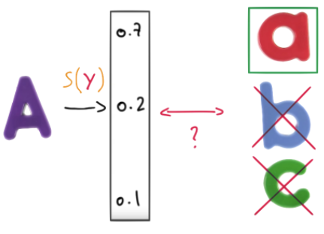
Test & one-hot encoding
hypothesis = tf.nn.softmax(tf.matmul(X,W)+b)
# Testing & One-hot encoding
a = sess.run(hypothesis, feed_dict={X: [[1, 11, 7, 9]]})
print(a, sess.run(tf.arg_max(a, 1)))
[[ 1.38904958e-03 9.98601854e-01 9.06129117e-06]] [1]
https://github.com/hunkim/DeepLearningZeroToAll/blob/master/lab-06-1-softmax_classifier.py

Slide 10
Test & one-hot encoding
hypothesis = tf.nn.softmax(tf.matmul(X,W)+b)
all = sess.run(hypothesis, feed_dict={X: [[1, 11, 7, 9],
[1, 3, 4, 3],
[1, 1, 0, 1]]})
print(all, sess.run(tf.arg_max(all, 1)))
[[ 1.38904958e-03 9.98601854e-01 9.06129117e-06]
[ 9.31192040e-01 6.29020557e-02 5.90589503e-03]
[ 1.27327668e-08 3.34112905e-04 9.99665856e-01]]
[1 0 2]
https://github.com/hunkim/DeepLearningZeroToAll/blob/master/lab-06-1-softmax_classifier.py

Slide 11
Lab 6-2
Fancy Softmax Classifier
cross_entropy, one_hot, reshape
With TF 1.0!
Sung Kim <hunkim+ml@gmail.com>
Code: https://github.com/hunkim/DeepLearningZeroToAll/

Slide 12
https://github.com/hunkim/DeepLearningZeroToAll/

Slide 13


softmax_cross_entropy_with_logits
logits = tf.matmul(X, W) + b
hypothesis = tf.nn.softmax(logits)
# Cross entropy cost/loss
cost = tf.reduce_mean(-tf.reduce_sum(Y * tf.log(hypothesis), axis=1))
# Cross entropy cost/loss
cost_i = tf.nn.softmax_cross_entropy_with_logits(logits=logits,
labels=Y_one_hot)
cost = tf.reduce_mean(cost_i)

Slide 14
hypothesis = tf.nn.softmax(tf.matmul(X,W))
tf.matmul(X,W)
https://www.udacity.com/course/viewer#!/c-ud730/l-6370362152/m-6379811817

Slide 15
softmax_cross_entropy_with_logits
logits = tf.matmul(X, W) + b
hypothesis = tf.nn.softmax(logits)
# Cross entropy cost/loss
cost = tf.reduce_mean(-tf.reduce_sum(Y * tf.log(hypothesis), axis=1))
# Cross entropy cost/loss
cost_i = tf.nn.softmax_cross_entropy_with_logits(logits=logits,
labels=Y_one_hot)
cost = tf.reduce_mean(cost_i)

Slide 16
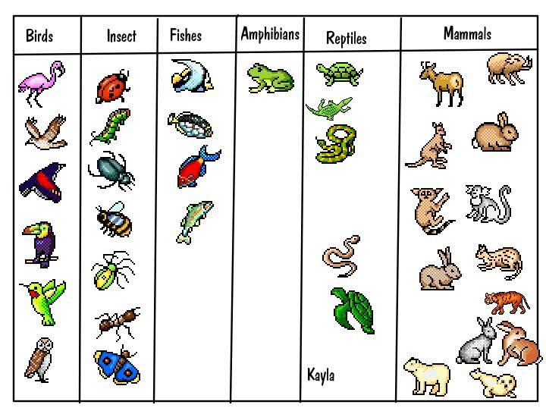
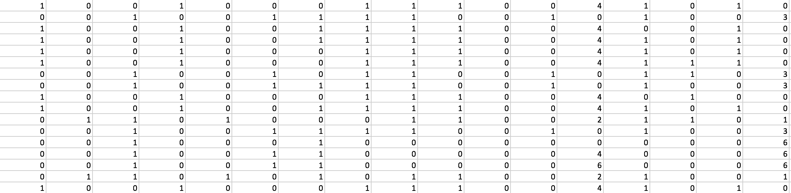
Animal classification
with softmax_cross_entropy_with_logits
# Predicting animal type based on various features
xy = np.loadtxt('data-04-zoo.csv', delimiter=',', dtype=np.float32)
x_data = xy[:, 0:-1]
y_data = xy[:, [-1]]
https://kr.pinterest.com/explore/animal-classification-activity/

Slide 17
tf.one_hot and reshape
Y = tf.placeholder(tf.int32, [None, 1]) # 0 ~ 6, shape=(?, 1)
Y_one_hot = tf.one_hot(Y, nb_classes) # one hot shape=(?, 1, 7)
Y_one_hot = tf.reshape(Y_one_hot, [-1, nb_classes]) # shape=(?, 7)
If the input indices is rank N, the output will have rank N+1. The new axis is created at dimension axis (default: the new axis is appended at the end). https://www.tensorflow.org/api_docs/python/tf/one_hot

Slide 18
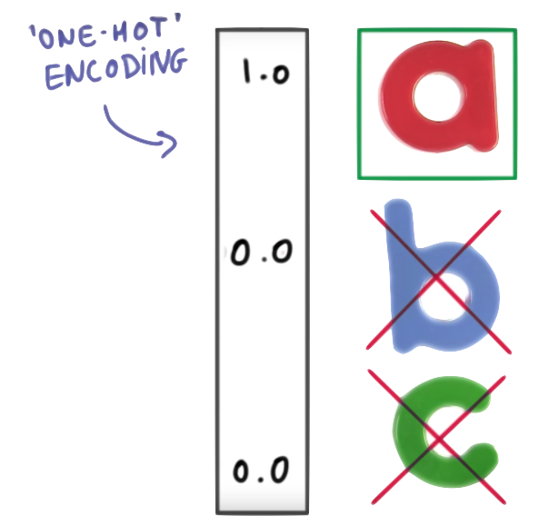
# Predicting animal type based on various features
xy = np.loadtxt('data-04-zoo.csv', delimiter=',', dtype=np.float32)
x_data = xy[:, 0:-1]
y_data = xy[:, [-1]]
nb_classes = 7 # 0 ~ 6
X = tf.placeholder(tf.float32, [None, 16])
Y = tf.placeholder(tf.int32, [None, 1]) # 0 ~ 6
Y_one_hot = tf.one_hot(Y, nb_classes) # one hot
Y_one_hot = tf.reshape(Y_one_hot, [-1, nb_classes])
W = tf.Variable(tf.random_normal([16, nb_classes]), name='weight')
b = tf.Variable(tf.random_normal([nb_classes]), name='bias')
# tf.nn.softmax computes softmax activations
# softmax = exp(logits) / reduce_sum(exp(logits), dim)
logits = tf.matmul(X, W) + b
hypothesis = tf.nn.softmax(logits)
# Cross entropy cost/loss
cost_i = tf.nn.softmax_cross_entropy_with_logits(logits=logits,
labels=Y_one_hot)
cost = tf.reduce_mean(cost_i)
optimizer = tf.train.GradientDescentOptimizer(learning_rate=0.1).minimize(cost)
https://github.com/hunkim/DeepLearningZeroToAll/blob/master/lab-06-2-softmax_zoo_classifier.py

Slide 19
cost = tf.reduce_mean(cost_i)
optimizer = tf.train.GradientDescentOptimizer(learning_rate=0.1).minimize(cost)
prediction = tf.argmax(hypothesis, 1)
correct_prediction = tf.equal(prediction, tf.argmax(Y_one_hot, 1))
accuracy = tf.reduce_mean(tf.cast(correct_prediction, tf.float32))
# Launch graph
with tf.Session() as sess:
sess.run(tf.global_variables_initializer())
for step in range(2000):
sess.run(optimizer, feed_dict={X: x_data, Y: y_data})
if step % 100 == 0:
loss, acc = sess.run([cost, accuracy], feed_dict={
X: x_data, Y: y_data})
print("Step: {:5}\tLoss: {:.3f}\tAcc: {:.2%}".format(
step, loss, acc))
# Let's see if we can predict
pred = sess.run(prediction, feed_dict={X: x_data})
# y_data: (N,1) = flatten => (N, ) matches pred.shape
for p, y in zip(pred, y_data.flatten()):
print("[{}] Prediction: {} True Y: {}".format(p == int(y), p, int(y)))
https://github.com/hunkim/DeepLearningZeroToAll/blob/master/lab-06-2-softmax_zoo_classifier.py

Slide 20
cost = tf.reduce_mean(cost_i)
optimizer = tf.train.GradientDescentOptimizer(learning_rate=0.1).minimize(cost)
prediction = tf.argmax(hypothesis, 1)
correct_prediction = tf.equal(prediction, tf.argmax(Y_one_hot, 1))
accuracy = tf.reduce_mean(tf.cast(correct_prediction, tf.float32))
# Launch graph
with tf.Session() as sess:
sess.run(tf.global_variables_initializer())
for step in range(2000):
sess.run(optimizer, feed_dict={X: x_data, Y: y_data})
if step % 100 == 0:
loss, acc = sess.run([cost, accuracy], feed_dict={
X: x_data, Y: y_data})
print("Step: {:5}\tLoss: {:.3f}\tAcc: {:.2%}".format(
step, loss, acc))
# Let's see if we can predict
pred = sess.run(prediction, feed_dict={X: x_data})
# y_data: (N,1) = flatten => (N, ) matches pred.shape
for p, y in zip(pred, y_data.flatten()):
print("[{}] Prediction: {} True Y: {}".
format(p == int(y), p, int(y)))
Step: 1100 Loss: 0.101 Acc: 99.01%
Step: 1200 Loss: 0.092 Acc: 100.00%
Step: 1300 Loss: 0.084 Acc: 100.00%
...
[True] Prediction: 0 True Y: 0
[True] Prediction: 0 True Y: 0
[True] Prediction: 3 True Y: 3
[True] Prediction: 0 True Y: 0
[True] Prediction: 0 True Y: 0
[True] Prediction: 0 True Y: 0
[True] Prediction: 0 True Y: 0
[True] Prediction: 3 True Y: 3
[True] Prediction: 3 True Y: 3
[True] Prediction: 0 True Y: 0
https://github.com/hunkim/DeepLearningZeroToAll/blob/master/lab-06-2-softmax_zoo_classifier.py

Slide 21
Lab 7
Learning rate, Evaluation
Sung Kim <hunkim+ml@gmail.com>

